Slide 1
Introduction to Computers and Programming
Let Us C by Yashavant Kanetkar
Chapter 2

Slide 2
Selection/Decision Control
The if statement
The if-else Statement
Decision depend upon conditions
The conditional operators
Equality
Relational

Slide 3
Programming Methodology
Before writing a program
Have a thorough understanding of problem.
Carefully plan your approach for solving it.
While writing a program
Know what “building blocks” are available
Use Good programming principles.

Slide 4
Algorithms:
Computing problems:
Solved by executing a series of actions in a specific order.
Algorithm a procedure determining
Actions to be executed
Order to be executed
Recipe.
Program Control
Specifies the order in which statements are executed.

Slide 5
Peudocode:
Artificial, informal language used to develop algorithms.
Similar to everyday English.
Not executed on computers.
Used to think out program before coding
Easy to convert in a C program

Slide 6
Flow Chart:
Graphical representation of an algorithm.
Special purpose symbols connected by arrows (flow lines).
Rectangle symbol (action symbol)
Any type of action.
Oval Symbol:
Beginning or end of a program, or a section of code (circles)

Slide 8
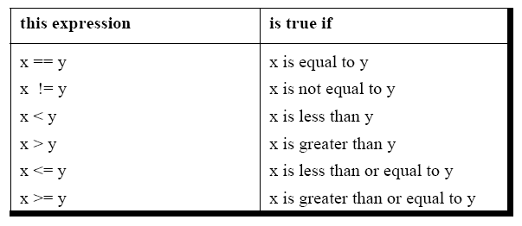
The if Statement
if ( expression/this condition is true )
execute this statement ;

Slide 9
Single-entry/Single exit
Non zero is true, zero is false.

Slide 10
is
A>B
Y
N
Print A
Print B

Slide 11
Demonstration of if statement
/* Demonstration of if statement */
main( )
{
int num ;
printf ( "Enter a number less than 10 " ) ;
scanf ( "%d", &num ) ;
if ( num <= 10 )
printf ( "What an obedient servant you are !" ) ;
}

Slide 12
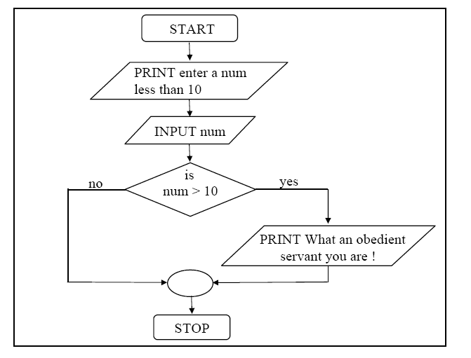

Slide 13
Examples:
While purchasing certain items, a discount of 10% is offered if the quantity purchased is more than 1000. If quantity and price per item are input through the keyboard, write a program to calculate the total expenses.

Slide 14
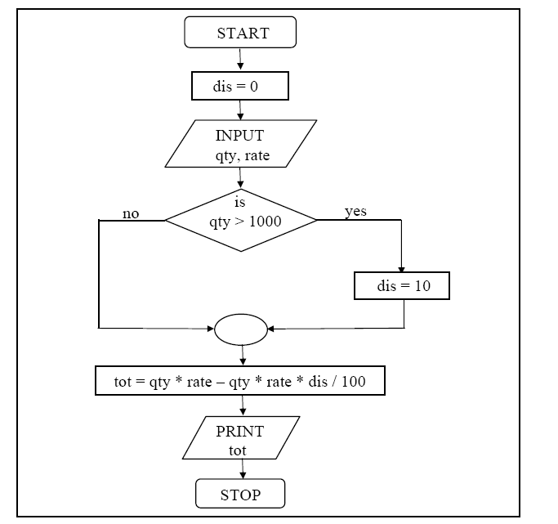

Slide 15
/* Calculation of total expenses */
main( )
{
int qty, dis = 0 ;
float rate, tot ;
printf ( "Enter quantity and rate " ) ;
scanf ( "%d %f", &qty, &rate) ;
if ( qty > 1000 )
dis = 10 ;
tot = ( qty * rate ) - ( qty * rate * dis / 100 ) ;
printf ( "Total expenses = Rs. %f", tot ) ;
}

Slide 16
Quick Test
if ( 3 + 2 % 5 )
printf ( "This works" ) ;
if ( a = 10 )
printf ( "Even this works" ) ;
if ( -5 )
printf ( "Surprisingly even this works" ) ;

Slide 17
Multiple IF Statements:
Compound Statements
Set of statements within a pair of braces.
BLOCK:
Set of statements within braces.

Slide 18
Example:
The current year and the year in which the employee joined the organization are entered through the keyboard. If the number of years for which the employee has served the organization is greater than 3 then a bonus of Rs. 2500/- is given to the employee. If the years of service are not greater than 3, then the program should do nothing.

Slide 19
main( )
{
int bonus, cy, yoj, yr_of_ser ;
printf ( "Enter current year and year of joining " ) ;
scanf ( "%d %d", &cy, &yoj ) ;
yr_of_ser = cy - yoj ;
if ( yr_of_ser > 3 )
{
bonus = 2500 ;
printf ( "Bonus = Rs. %d", bonus ) ;
}
}

Slide 20
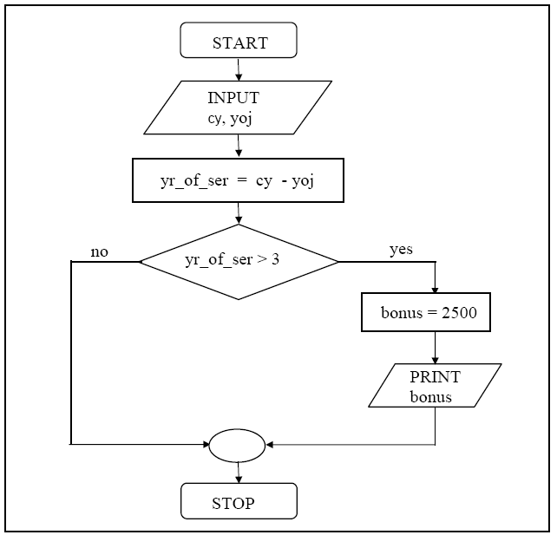

Slide 21
The if-else Statement
If/else
Different actions if conditions true or false.
Pseudo code:
If student’s grade is greater than or equal to 60
Print “passed”
else
Print “failed”
Code
If(grade >= 60)
Printf(“passed”);
else
Printf(“passed”);

Slide 22
Example:
In a company an employee is paid as under:
If his basic salary is less than Rs. 1500, then HRA = 10% of basic salary and DA = 90% of basic salary. If his salary is either equal to or above Rs. 1500, then HRA = Rs. 500 and DA = 98% of basic salary. If the employee's salary is input through the keyboard write a program to find his gross salary.

Slide 23
Calculation of gross salary
main( )
{
float bs, gs, da, hra ;
printf ( "Enter basic salary " ) ;
scanf ( "%f", &bs ) ;
if ( bs < 1500 )
{
hra = bs * 10 / 100 ;
da = bs * 90 / 100 ;
}
else
{
hra = 500 ;
da = bs * 98 / 100 ;
}
gs = bs + hra + da ;
printf ( "gross salary = Rs. %f", gs ) ;
}

Slide 24
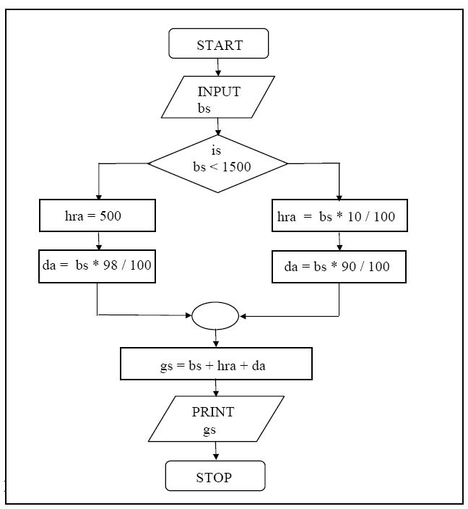

Slide 25
Ternary Condition:
The conditional operators ? and : are sometimes called ternary operators since they take three arguments.
expression 1 ? expression 2 : expression 3
“if expression 1 is true (that is, if its value is non-zero), then the value returned will be expression 2, otherwise the value returned will be expression 3”.

Slide 26
Ternary conditional operator (? :)
Three arguments (condition, value if true, value if false)
Code could be written:
(grade >= 60 ? “PASSED” : “FAILED”);
1) char a ; int y ;
scanf ( "%c", &a ) ;
y = ( a >= 65 && a <= 90 ? 1 : 0 ) ;
2) int x, y ; scanf ( "%d", &x ) ;
y = ( x > 5 ? 3 : 4 ) ;
if ( x > 5 )
y = 3 ;
else
y = 4 ;

Slide 27
Nested if-else:
One inside another, test for multiple cases
Once condition met, other statements skipped.
Pseudo code:
If students grade is greater than or equal to 90
“Print A”
else
If students grade is greater than or equal to 80
“Print B”
else
If students grade is greater than or equal to 70
“Print C”
else
If students grade is greater than or equal to 60
“Print D”
else
“Print F”

Slide 28
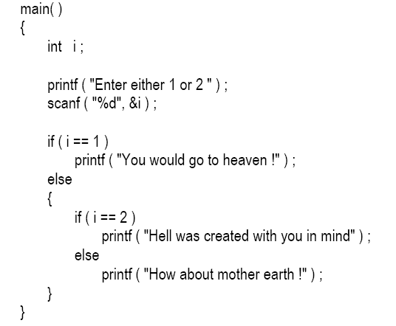

Slide 29
Logical Operators:
&& (Logical AND)
True if both conditions are true
If (gender == F && age >= 65)
Senior Females;
|| (Logical OR)
True if either of condition is true
If ( semesterAverage >= 90 || finalexam >= 90)
printf(“student grade is A”);
! (Logical NOT, logical negation)
Returns true when its condition is false, & vice versa
If ( ! (colour == red ) )
printf(“it’s not a bright colour”);

Slide 30
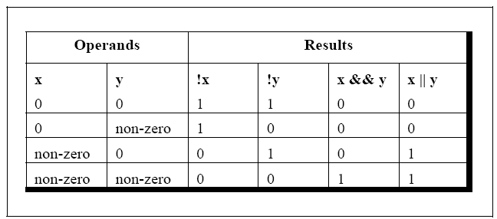

Slide 31
Sample Program:
To calculate the division
Input: marks of 2 different subjects
Rules:
Percentage above or equal to 60 - First division
Percentage between 50 and 59 - Second division
Percentage between 40 and 49 - Third division
Percentage less than 40 - Fail
Solution:
Nested if-else
Logical operators

Slide 32
if ( per >= 60 )
printf ( "First division ") ;
else
{
if ( per >= 50 )
printf ( "Second division" ) ;
else
{
if ( per >= 40 )
printf ( "Third division" ) ;
else
printf ( "Fail" ) ;
}
}

Slide 33
if ( per >= 60 )
printf ( "First division ") ;
if (( per >= 50 ) && (per < 60))
printf ( "Second division" ) ;
if (( per >= 40 ) && (per < 50))
printf ( "Third division" ) ;
if ( per < 40 )
printf ( "Fail" ) ;

Slide 34
Else-if Statement
if ( per >= 60 )
printf ( "First division ") ;
else if ( per >= 50 )
printf ( "Second division" ) ;
else if ( per >= 40 )
printf ( "Third division" ) ;
else
printf ( "Fail" ) ;

Slide 35
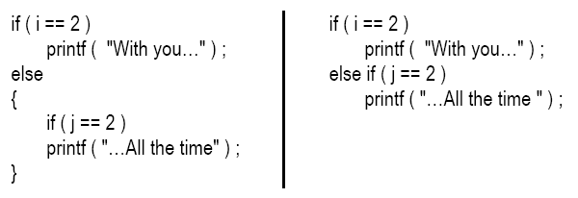
Cont’d:
Note that the else if clause is nothing different. It is just a way of rearranging the else with the if that follows it. This would be evident if you look at the following code:

Slide 36
Using Logical Operators
A company insures its drivers in the following cases:
If the driver is married
If the driver is unmarried, male and above 30 years of age
If the driver is unmarried, female and above 25 years of age.

Slide 37
if ( ms == 'M' )
printf ( "Driver is insured" ) ;
else
{
if ( sex == 'M' )
{
if ( age > 30 )
printf ( "Driver is insured" ) ;
else
printf ( "Driver is not insured" ) ;
}
else
{
if ( age > 25 )
printf ( "Driver is insured" ) ;
else
printf ( "Driver is not insured" ) ;
}
}

Slide 38
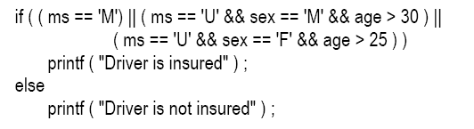

Slide 39
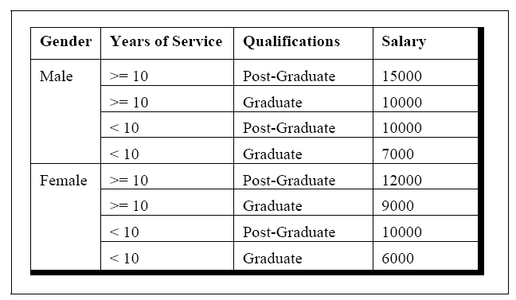
Salary Calculation Example:
Write a program to calculate the salary as per the following table:

Slide 40
main( )
{
char g ;
int yos, qual, sal ;
printf ( "Enter Gender, Years of Service and Qualifications ( 0 = G, 1 = PG ):" ) ;
scanf ( "%c%d%d", &g, &yos, &qual ) ;
if ( g == 'm' && yos >= 10 && qual == 1 )
sal = 15000 ;
else if ( ( g == 'm' && yos >= 10 && qual == 0 ) ||
( g == 'm' && yos < 10 && qual == 1 ) )
sal = 10000 ;
else if ( g == 'm' && yos < 10 && qual == 0 )
sal = 7000 ;
else if ( g == 'f' && yos >= 10 && qual == 1 )
sal = 12000 ;
else if ( g == 'f' && yos >= 10 && qual == 0 )
sal = 9000 ;
else if ( g == 'f' && yos < 10 && qual == 1 )
sal = 10000 ;
else if ( g == 'f' && yos < 10 && qual == 0 )
sal = 6000 ;
printf ( "\nSalary of Employee = %d", sal ) ;
}

Slide 41
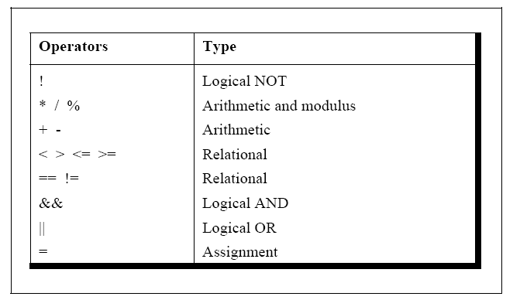
Hierarchy of Operators Revisited

Slide 42
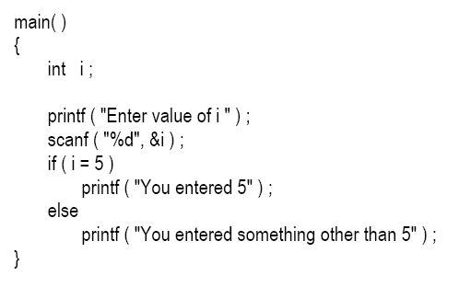
A Word of Caution

Slide 43
Cont’d:
main( )
{
int i ;
printf ( "Enter value of i " ) ;
scanf ( "%d", &i ) ;
if ( i == 5 ) ;
printf ( "You entered 5" ) ;
}

Slide 44
End..

